Slide 1
Chapter 1:
Data Presentation
& Boolean Operations

Slide 2
Data Representation
Binary Numbers
  Translating between binary and decimal
Binary Addition
Integer Storage Sizes
Hexadecimal Integers
  Translating between decimal and hexadecimal
  Hexadecimal subtraction
Signed Integers
  Binary subtraction
Character Storage

Slide 3
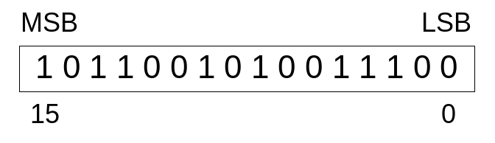
Binary Numbers
Digits are 1 and 0
  1 = true
  0 = false
MSB – most significant bit
LSB – least significant bit
Bit numbering:

Slide 4

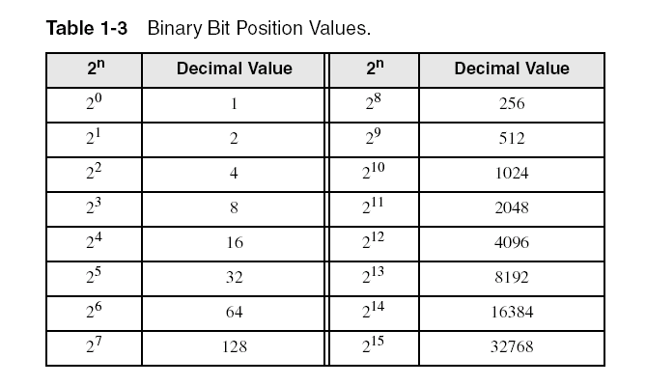
Binary Numbers
Each digit (bit) is either 1 or 0
Each bit represents a power of 2:
Every binary number is a sum of powers of 2

Slide 5
Translating Binary to Decimal
Weighted positional notation shows how to calculate the decimal value of each binary bit:
dec = (D_{n-1} × 2^{n-1}) + (D_{n-2} × 2^{n-2}) + ... + (D₁ × 2¹) + (D₀ × 2⁰)
D = binary digit
binary 00001001 = decimal 9:
(1 × 2³) + (1 × 2⁰) = 9

Slide 6
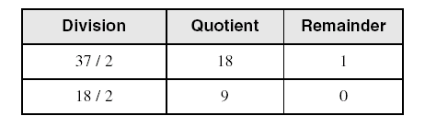
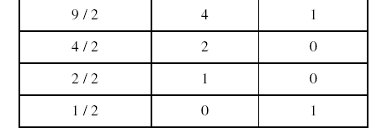
Translating Unsigned Decimal to Binary
Repeatedly divide the decimal integer by 2. Each remainder is a binary digit in the translated value:
37 = 100101

Slide 7
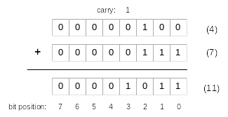
Binary Addition
Starting with the LSB, add each pair of digits, include the carry if present.

Slide 8

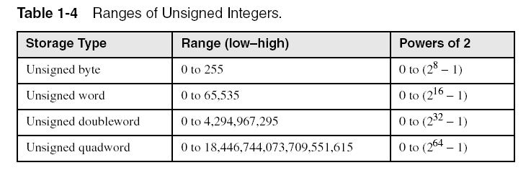
Integer Storage Sizes
Standard sizes:
What is the largest unsigned integer that may be stored in 20 bits?

Slide 9
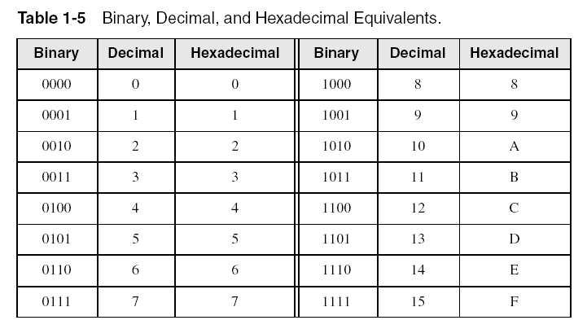
Hexadecimal Integers
Binary values are represented in hexadecimal.

Slide 10

Translating Binary to Hexadecimal
Each hexadecimal digit corresponds to 4 binary bits.
Example: Translate the binary integer 000101101010011110010100 to hexadecimal:

Slide 11
Converting Hexadecimal to Decimal
Multiply each digit by its corresponding power of 16:
  dec = (D₃ × 16³) + (D₂ × 16²) + (D₁ × 16¹) + (D₀ × 16⁰)
Hex 1234 equals (1 × 16³) + (2 × 16²) + (3 × 16¹) + (4 × 16⁰), or decimal 4,660.
Hex 3BA4 equals (3 × 16³) + (11 * 16²) + (10 × 16¹) + (4 × 16⁰), or decimal 15,268.
Irvine, Kip R. Assembly Language for Intel-Based Computers 6/e, 2010.

Slide 12
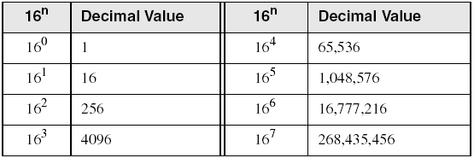
Powers of 16
Used when calculating hexadecimal values up to 8 digits long:
Irvine, Kip R. Assembly Language for Intel-Based Computers 6/e, 2010.

Slide 13
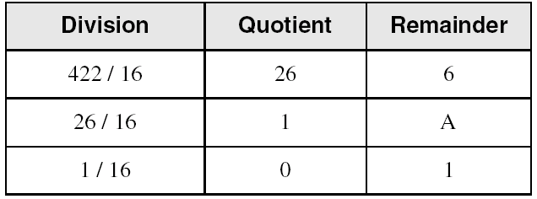
Converting Decimal to Hexadecimal
decimal 422 = 1A6 hexadecimal

Slide 14
Hexadecimal Addition
Divide the sum of two digits by the number base (16). The quotient becomes the carry value, and the remainder is the sum digit.
1
1
36 28 28 6A
42 45 58 4B
78 6D 80 B5
21 / 16 = 1, rem 5
Important skill: Programmers frequently add and subtract the addresses of variables and instructions.

Slide 15
Hexadecimal Subtraction
When a borrow is required from the digit to the left, add 16 (decimal) to the current digit's value:
16 + 5 = 21
−1
C6 75
A2 47
24 2E
Practice: The address of var1 is 00400020. The address of the next variable after var1 is 0040006A. How many bytes are used by var1?

Slide 16
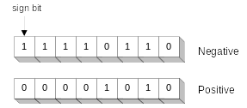
Signed Integers
The highest bit (MSB) indicates the sign. 1 = negative,
0 = positive
If the highest digit of a hexadecimal integer is > 7, the value is negative. Examples: 8A, C5, A2, 9D
Irvine, Kip R. Assembly Language for Intel-Based Computers 6/e, 2010.

Slide 17
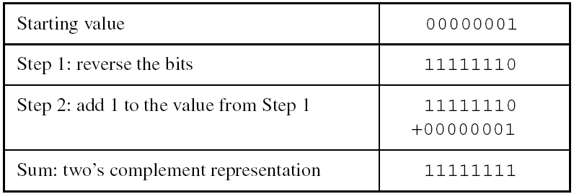
Forming the Two's Complement
Negative numbers are stored in two's complement notation
Represents the additive Inverse
Note that 00000001 + 11111111 = 00000000
Irvine, Kip R. Assembly Language for Intel-Based Computers 6/e, 2010.

Slide 18
Binary Subtraction
When subtracting A – B, convert B to its two's complement
Add A to (–B)
0 0 0 0 1 1 0 0 0 0 0 0 1 1 0 0
– 0 0 0 0 0 0 1 1 1 1 1 1 1 1 0 1
0 0 0 0 1 0 0 1
Practice: Subtract 0101 from 1001.

Slide 19
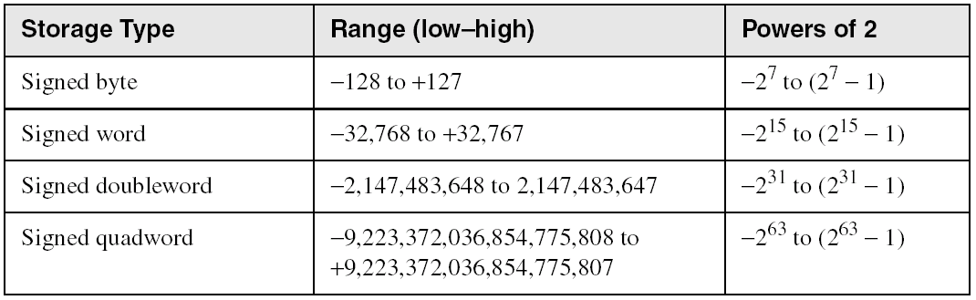
Ranges of Signed Integers
The highest bit is reserved for the sign. This limits the range:
Practice: What is the largest positive value that may be stored in 20 bits?

Slide 20
Learn How To Do the Following:
Form the two's complement of a decimal integer
  Reverse all bits and add 1
Convert signed binary to decimal
  Highest bit=1, create its two’s complement again
  Highest bit=0, convert to decimal directly
Convert signed decimal to binary
  Positive: following unsigned conversion
  Negative: Convert its positive value to binary, then reverse all bits and add 1
Convert signed decimal to hexadecimal
  Same as above
Convert signed hexadecimal to decimal
  Same as signed binary to decimal

Slide 21
Character Storage
Character sets
  Standard ASCII (0 – 127)
  Extended ASCII (0 – 255) (2⁸-1)
  ANSI (0 – 255)
  Unicode (0 – 65,535) (2¹⁶-1)
Null-terminated String
  Array of characters followed by a null byte
Using the ASCII table
  back inside cover of book

Slide 22
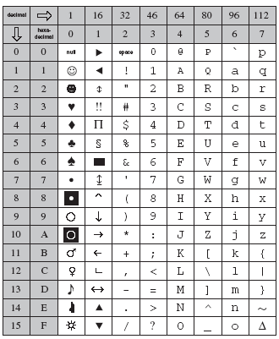

Slide 23
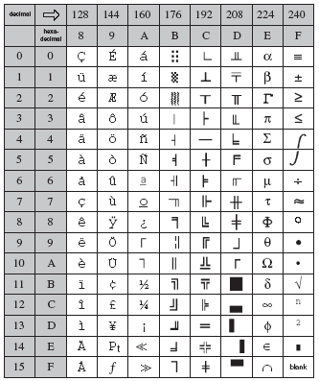

Slide 24
Numeric Data Representation
pure binary
  can be calculated directly
ASCII binary
  string of digits: "01010101"
ASCII decimal
  string of digits: "65"
ASCII hexadecimal
  string of digits: "9C"
next: Boolean Operations

Slide 25
Boolean Operations
NOT
AND
OR
Operator Precedence
Truth Tables

Slide 26
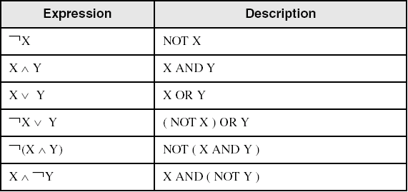
Boolean Algebra
Based on symbolic logic, designed by George Boole
Boolean expressions created from:
  NOT, AND, OR

Slide 27
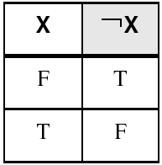
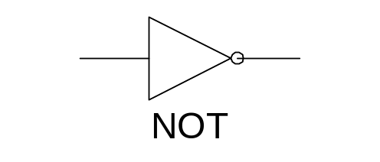
NOT
Inverts (reverses) a boolean value
Truth table for Boolean NOT operator:
Digital gate diagram for NOT:

Slide 28
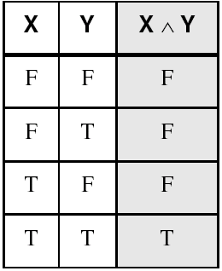
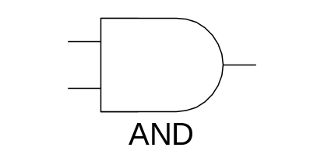
AND
Truth table for Boolean AND operator:
Digital gate diagram for AND:

Slide 29
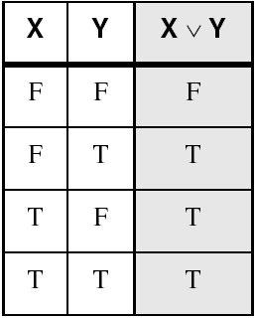
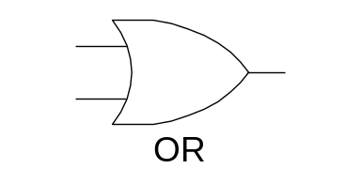
OR
Truth table for Boolean OR operator:
Digital gate diagram for OR:

Slide 30
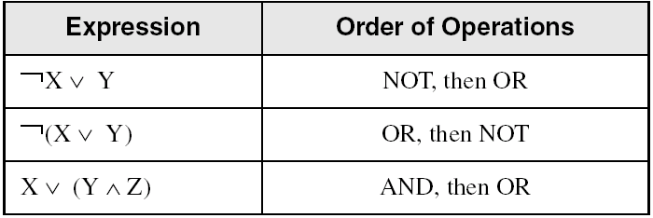
Operator Precedence
Examples showing the order of operations:

Slide 31
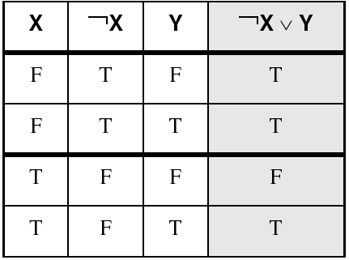
Truth Tables (1 of 3)
A Boolean function has one or more Boolean inputs, and returns a single Boolean output.
A truth table shows all the inputs and outputs of a Boolean function
Example: ¬X ∨ Y

Slide 32
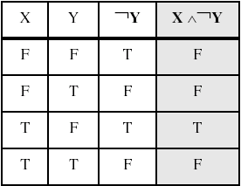
Truth Tables (2 of 3)
Example: X ∧ ¬Y

Slide 33
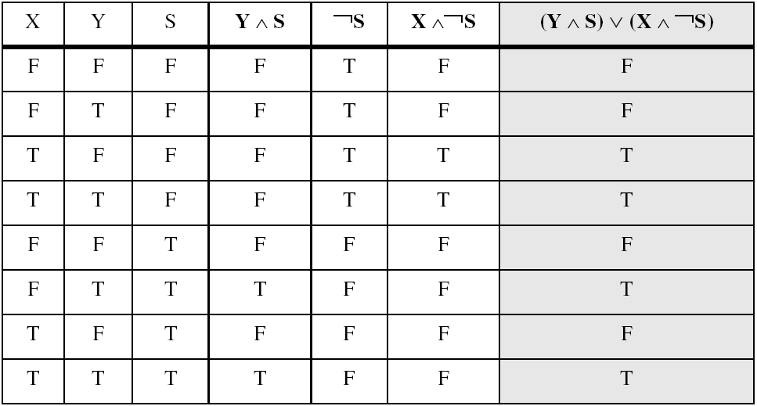
Truth Tables (3 of 3)
Example: (Y ∧ S) ∨ (X ∧ ¬S)
Two-input multiplexer

Slide 34
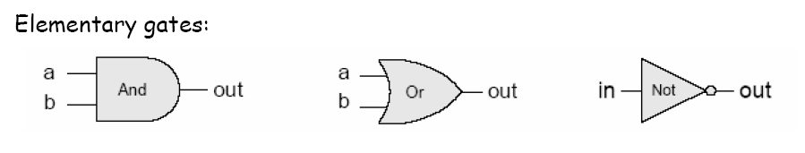
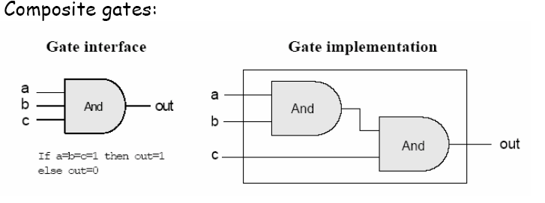
Gate Logic
A gate architecture designed to implement a boolean function

Slide 35
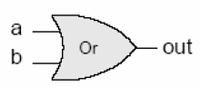

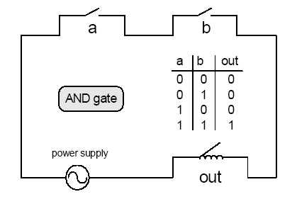
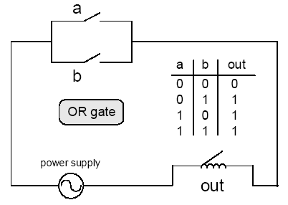
Circuit Implementations

Slide 36
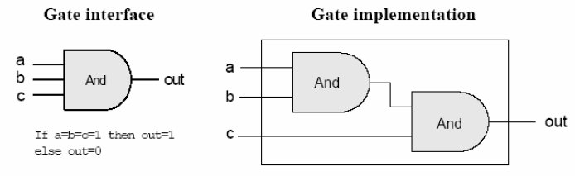
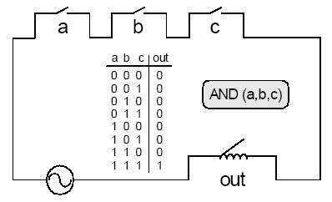
Circuit Implementations

Slide 37
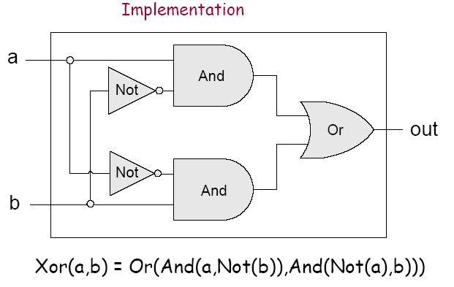
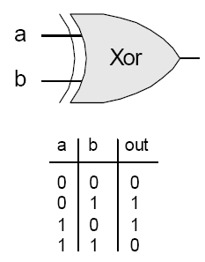
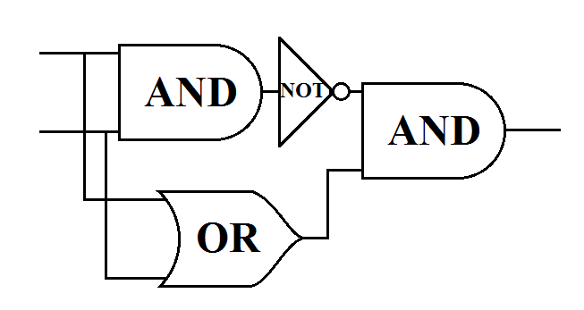
Composite gates

